Slide 1

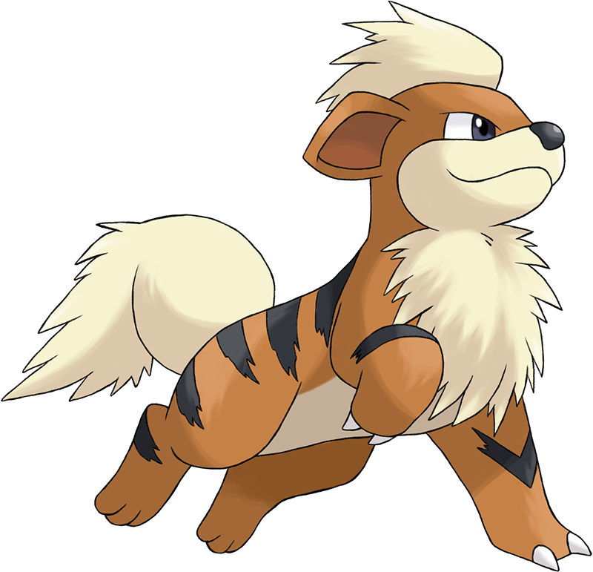
Catch these Poké-Hands
Ian Arch, Paige Breyfogle, Daniel Buescher, Andrew Stepanek

Slide 2
Gameplan
Goal: Expand on the data from our prior project and create a Machine Learning algorithm to predict the winner of a fight based on stats, also have an ML algorithm to predict a Pokémon’s type based on stats
“Everyone has a plan, until they get punched in the mouth”- Iron Mike Tyson
These are the snags/problems that we encountered along the way

Slide 3
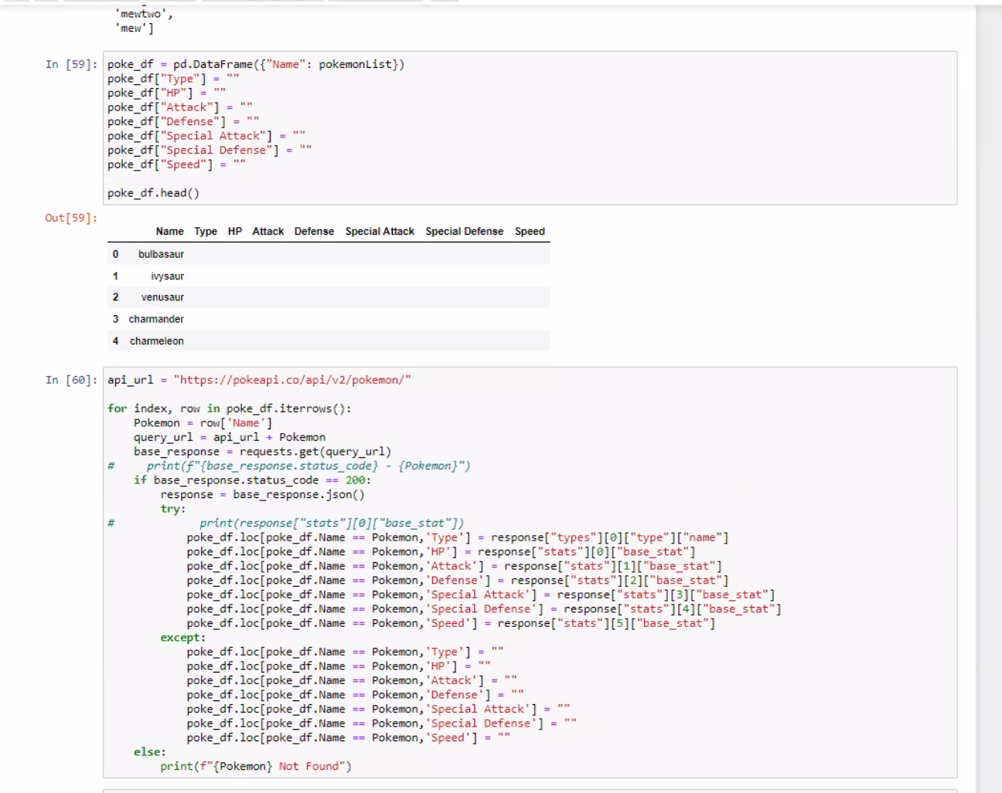
Process
We expanded on a previous dataset

Slide 4
Process

Slide 5
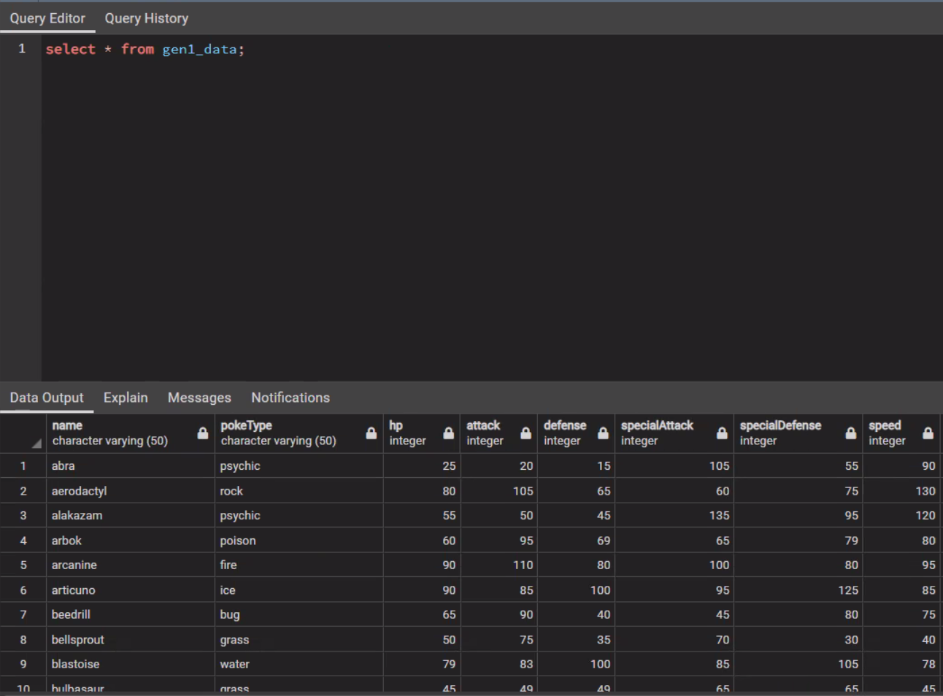
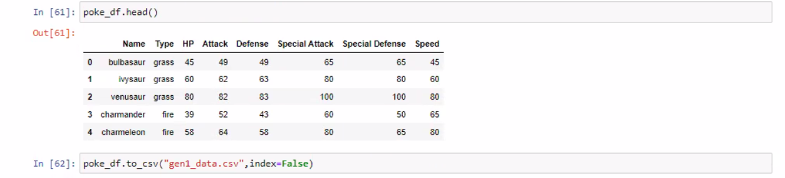
Process

Slide 6
Machine Learning

Slide 7

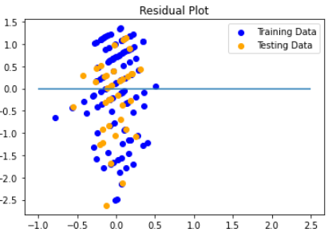
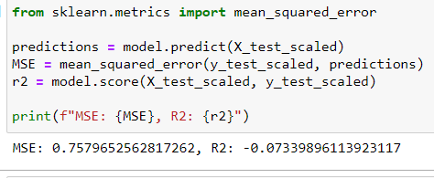
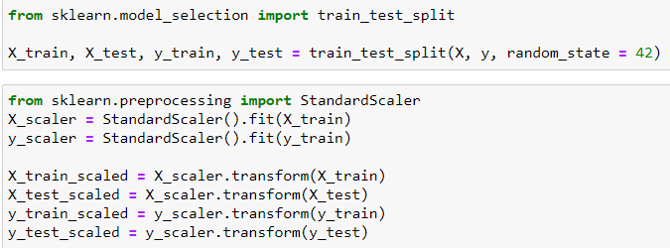
Machine Learning
ML algorithm to predict type based on inputted stats
Types are not defined by stat thresholds

Slide 8
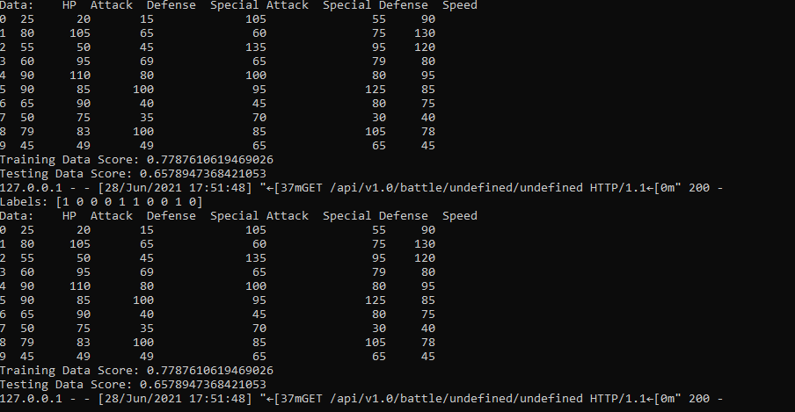

Lost Battles Trials & Tribulations

Slide 9
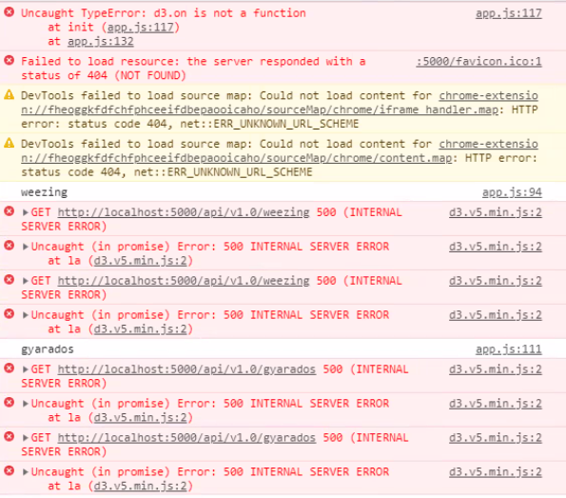
Lost Battles Trials & Tribulations

Slide 10
Lost Battles Trials & Tribulations

